Slide 1
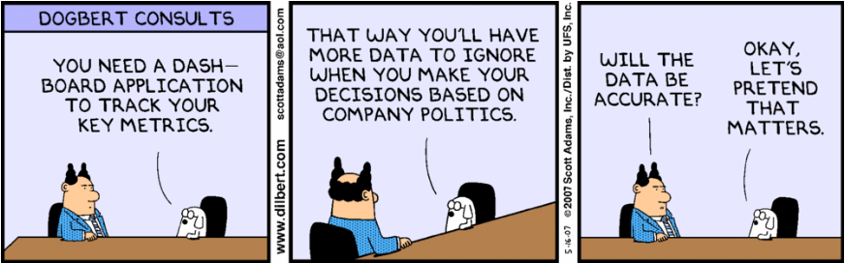
Politics of Project Management
Phil Pfeiffer
Fall 2014

Slide 2
Politics: Definitions
Politics = working for goals within a community
  Polity - from polis, city (Greek)
  Essential for effective action
Politics as it should be:
Logical extension of ethics to larger groups, consistent with ethical behavior and the universe as we know it.
-- Aristotle, cited in Peopleware (DeMarco and Lister)
Dysfunctional politics:
Responsibility without authority.
-- ? (can't find a source)
All too often, too few resources chasing too many responsibilities.

Slide 3

Politics and Project Management
[P]olitical problems are often the cause of failure in building systems. This is recognized intuitively by most of us, but the extent of the political impact is rarely appreciated.
-- Robert Block, The Politics of Projects
Politics:
Those actions and interactions with people
outside your direct control that affect the achievement of your goals.
Project politics:
The actions and interactions between project team members and people outside the team that have impact on the success of the project, its system, the project team,
and the project manager

Slide 4
Source: http://www.shrm.org/Conferences/StaffingManagementConferenceExpo/Documents/10Confsessions/10Staff_Eskenazi.pdf
 | Political Styles Politics viewed as
Action Orien-tation |  | negative | neutral | positive
 | initiates | machiavellian manipulator looks out for #1 | responsible obligation comes with territory | leader playmaker impact player
 | predicts | protector file builder defensive | speculator grapeviner | advisor counselor
 | responds | cynic I told you so gossip | fatalist que sera sera | spectator fan encourager

Slide 5
Source: http://www.shrm.org/Conferences/StaffingManagementConferenceExpo/Documents/10Confsessions/10Staff_Eskenazi.pdf
 | - Organizational Interest +
+Self Interest - | Dysfunctional politics | Functional politics
 | Self-destructive behavior | Sacrificial behavior

Slide 6
Observations
Politics usually boils down to self-interest and how it plays out in organizations
Machiavellian politics lives in upper left-hand corner
▪ e.g.: agreeing to boss's idea though it's not good in
order to curry favor
Upper right-hand corner: where political savvy dwell
▪ active players may occasionally drop down into lower two quadrants -- e.g., for organizational good
▪ be wary of spending too much time in lower right:
prescription for burn-out
Source: http://www.shrm.org/Conferences/StaffingManagementConferenceExpo/Documents/10Confsessions/10Staff_Eskenazi.pdf

Slide 7
Projects and Politics
Organizations don't need projects - they need systems.
However
  Systems must be built by experts
  Experts usually part of specialized group
  Specialized group consumes extensive resources
  Projects are complex and unpredictable
Hence, projects take on alien, necessarily evil quality
  Needed but not trusted
  At slightest sign of problems, becomes even more suspect

Slide 8
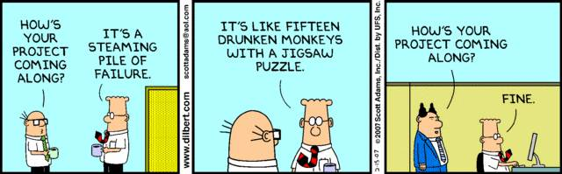
Dysfunctional Projects: 12 Causes
Resource failures
  imposed deadlines plus management inability / unwilligness to provide adequate resources for project
Requirements failures
  incomplete, incorrect, and/or unclear requirements
Goal failures
  inadequate or incorrect statement of systems goals by management
  misunderstanding of goals by developers
Technique failures
  failure by builders to use effective development techniques
Robert Block, The Politics of Projects

Slide 9
Dysfunctional Projects: 12 Causes
User contact failures
  inability to communicate with the user community
  result: they don't want system and don't know how to use it properly
Organizational failures
  inability of organization to support project: e.g., lack of cooperation
Technology failures
  hardware and/or software won't function as required
  usually, involves cutting edge technology
Size failures
  the system is too big
People management failures
  failure to motivate and maintain morale
Methodology failures
  too much, too little, and/or inappropriate discipline
Planning and control failures
  planning, scheduling, task assignment, tracking of results
Personality failures
  clashes within groups or between group members and members of interfacing groups.
Robert Block, The Politics of Projects

Slide 10
Area of concern | Extent to which concern is controlled by people external to project group (analysis: Block)
Resources | Unless estimates based on ones by systems group, problems almost always due to external mgmt decisions.
Requirements | Often, systems group does poor job with requirements. More often, inadequate specs due to bad source outside of group or bad information from users.
Goals | Unless systems group misunderstands or ignores goals, goals typically vaguely defined, wrong, or nonexistent.
Techniques | Ought to be internal, but mgmt may insist on old standards, refuse to train people or fail to support use of techniques.
User contact | Mostly, due to unwilling, uninterested, and unavailable users.
Organizational | Internal problems unusual, except when group large enough to require multiple subgroups. Inefficient upper mgmt and fragmentation of responsibilities much more common.

Slide 11
Area of concern | Extent to which concern is controlled by people external to project group (analysis: Block)
Technology | Selection of hardware and software products almost always by people outside of systems group.
Size | Pressure for big systems usually from users and DP management. Group leader can sometimes push back.
People mgmt | Skilled group leaders can provide effective leadership in spite of outside forces.
Methodology | "As with people management, there may be lots of pressure to do it wrong, but the leader still has the option to do it right."
Planning, control | "The enforced use of a clumsy control tool might cost some overhead, but this area is still under the leader's control."
Personalities | Most clashes involve people who are not group members.

Slide 12
Area of concern | Extent to which concern is controlled by people external to project group (analysis: Robert Block)
Resources
Requirements
Goals
Techniques
User contact
Organizational
Technology
Size
People mgmt
Methodology
Planning, control
Personalities

Slide 13
Managing Organizational Politics
Importance: most of project's success due to concerns outside of project leader's direct control
  See previous slide
One key to project success: keeping users-eye view
  Users keep IT people in business
  Users stand to rise or fall with project
  Cultivate relationship with users
    Let them know you care
    Do things that must done,
    as simply and quickly as possible
Another key to success: managing political process

Slide 14
Block's Process: Evaluate These First
Project's rules for system building
  Methodology; project control systems and procedures;
  procedures for review, approval, funding; user interaction protocol
The players
  Members of project team, including their skill sets
  External players, including likely support and resistance from each
Project and system goals and constraints
  System goals: functions, systems to replace, performance, reliability
  Constraints: hardware, software, packages, environment
  Project goals: required products, productivity
  Constraints: due dates, expense limits, resource availability, facilities, logistics
Responsibility and authority
  Explicit responsibilities: what you and your team are to produce
  Implicit responsibilities: what you will get blamed for if project fails
  Authority: what you are allowed change
Feasibility of success - based on four concerns above

Slide 15
Block's Process: Steady State
Your skills, relative to ways of interacting with players (phone, e-mail, presentations, etc.)
Observations about players
1. Identify Goals
Management and user needs
2. Assess Capabilities
Personal interests and motivations: yours, team members
3. Assess Environment
Political skills
6. Implement and Monitor
Project and
system goals
Organization, Profiles, and Networks
5. Formulate Solutions
4. Delineate Problems
Control flows
Data flows

Slide 16
Block's Process: Assessing Environment
Positive relationships: examples
  Influence
  Delegated authority
  Allies
  Information channel
  Patron - protégé
  Friendships
Negative relationships: examples
  Kid gloves: dislike tempered with respect
    The best one can do
  Non-friends: degree of dislike between individuals
  Enemies

Slide 17
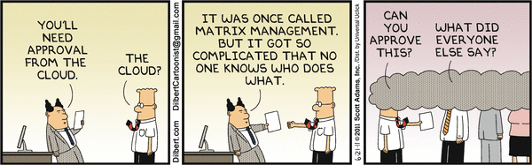
Block's Process: Assessing Environment
For each process the project must be part of
  For each group or title in that process
    Identify flow of information through group or title
    Identify person or people from group or title involved in flow
Document formal organization surrounding all groups and titles
  Draw formal organizational chart surrounding all groups and titles
    Include 1 or 2 levels above groups and titles
  Describe responsibility and structure of each group

Slide 18
Block's Process: Assessing Environment
Profile key players
  Responsibility and authority; goals and motivations; history
Document relationships in networks within organization
  Your network
  To the best of your ability, networks of key players
Nurture your network

Slide 19
Block's Process: Delineating Problems
Problem statement
  The difference between what is, what you want it to be
Two strategies for identifying problems
  With products
    Consider each external deliverable, subcontractor's product, review, and required approval
  With people
    Review each player in disciplined way
    Empathize with point of view

Slide 20
Block's Process: Implement & Monitor
Block suggests weekly meetings for reviewing , going forward
Six characteristics of successful politicians:
  Introspection: understanding of own goals and motivations
  Control: manages own emotions; less susceptible to tricks
  Insight into goals and motivations of others
  Accurate perception of reality
  Ability to think creatively and recognize and accept creative ideas from others
  Tenacity: the most significant quality in winning politicans

Slide 21
Politics: More Recommended Strategies
Set and manage expectations really well
▪ Goals, Roles, Process, Timelines, Consequences
Depersonalize debate
▪ eliminate "you" from conversation
▪ argue based on data - particularly when critiquing bad ideas
▪ find win-win strategies
▪ enlist others as partners
Build relationships
▪ Deal directly with others
▪ going over people's heads usually counterproductive
▪ Build strong relationships with key people
▪ face-to-face - not just e-mail
Source: http://www.shrm.org/Conferences/StaffingManagementConferenceExpo/Documents/10Confsessions/10Staff_Eskenazi.pdf

Slide 22
Politics: More Recommended Strategies
Communicate regularly, with credibility
▪ Talk more about what you HAVE DONE and DID WORK,
less about what you WILL DO and MIGHT WORK
▪ Confidence, credibility = track record of delivering on commitments
▪ No news = bad news. Communicate frequently.
▪ Practice specificity
▪ Send follow-up CYA e-mail after key decisions, changes
Manage problems head-on
On failures, highlight successes, complete post-mortems
▪ Reward and thank successful efforts
▪ Learn from mistakes and bring visibility to cause-effect
Source: http://www.shrm.org/Conferences/StaffingManagementConferenceExpo/Documents/10Confsessions/10Staff_Eskenazi.pdf

Slide 23
Concluding Thoughts: Block
Political process is ethically neutral
  If you need to ask yourself if you're ready to play hardball, you aren't
If you are politically active, someone at some point will do something dirty to you
  Block, however, encourages people to consider human decency in all actions, "because it is ultimately necessary for survival and simply the way to be"

